Slide 1
Music Recommendation Based On Facial Emotions Recognition
Guided By :
Mr. Anay Tamhankar
Ms. Trupti Joshi
Mr. Prasad Deshmukh
Presented By :
Siddharth Gadewal (230943025048)
Harshada Samant (230943025022)
Anushka Autade (230943025009)
Ganesh Khedkar (230943025018)

Slide 2

Index
Introduction
Problem Statement
Technologies Used
Architecture
About Data
Data Processing
System Components
Hurdles
Conclusion & Achievements
Future Scope

Slide 3
Introduction
Immerse yourself in a musical journey where your emotions guide the playlist selection, thanks to our innovative fusion of deep learning CNN technology and mood-based song recommendations. Explore our project's use of deep learning CNN technology to recommend music based on facial expressions. Dive into personalized song suggestions that match your mood seamlessly

Slide 4
4
Problem Statement
Develop a Musical system which will generate a musical playlist for the user based on his/her mood, by capturing his/her facial expressions.

Slide 5
5
Technologies Used
Spotipy Library
Spark
Random Forest Classifier
CNN (Convolution Neural Network)
OpenCV2
MongoDB

Slide 6

6
Architecture
Image Dataset
Training the CNN model
Capturing the face of user using the webcam
Facial feature extraction
Generating the playlist
Recommender System
Detecting the emotion
Music Feature Extraction
MongoDB

Slide 7
7
About Data
Facial Expression Recognition 2013 (FER 2013) dataset is used.
The data consists of 48x48 pixel gray scale images of faces.
The faces have been categorized into facial expression in to one of seven categories (0=Angry, 1=Disgust, 2=Fear, 3=Happy, 4=Sad, 5=Surprise, 6=Neutral).
A dataset containing music features and emotions is utilized for training the recommendation system.

Slide 8
Data Processing
Extracting song features
music dataset is preprocessed to extract relevant features such as acousticness, danceability, energy, etc.
Handling missing values.
Extracting image features
Using image dataset created a csv file with columns emotion and pixel to train the model.

Slide 9
9
System Components
Facial Expression Recognition using Convolution Neural Network(CNN)
OpenCV for face detection
Spotify API for fetching music data
MongoDB used to store data
Recommendation Engine based on user emotion

Slide 10
Music Classification Model
Model training
Algorithm used
Accuracy
Testing new data
Classification of data

Slide 11
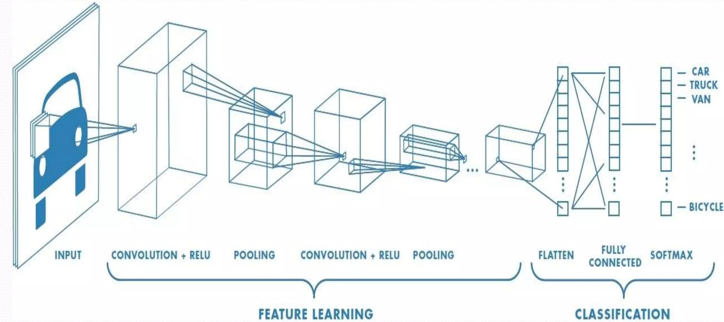
CNN
11

Slide 12
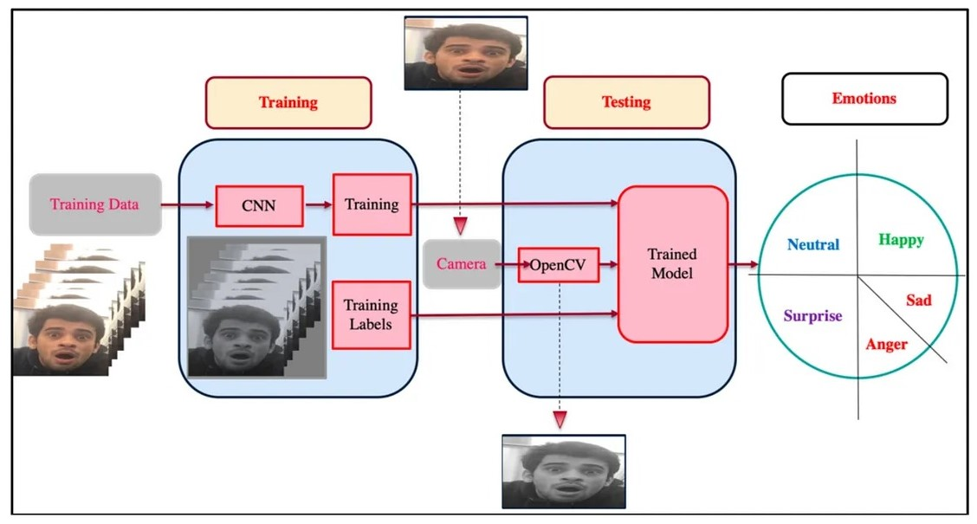
12

Slide 13
Recommender System
Establish MongoDB connection.
Retrieve data from MongoDB.
Utilize spotify API for additional information.
Randomly select 10 songs using sample aggregation.
Display the recommended songs.

Slide 14
Hurdles
Data Extraction
Data Preprocessing
Model Tuning

Slide 15
Conclusion & Achievements
OpenCV Integration
Utilized OpenCV for real-time facial emotion detection, enhancing the interactivity and user experience.
Facial Emotion Detection
Leveraged a Convolutional Neural Network (CNN) model to detect facial emotions in real-time through webcam input.
Music Recommender System
Implemented a Spotify-based Music Recommender System that tailors song recommendations based on the user's detected emotion.

Slide 16
16
Future Scope
Explore the possibility of expanding the recommendation system to include additional features such as user preferences, genre-specific filters, etc.
Direct Integration with spotify

Slide 17
Thank you

